Slide 1
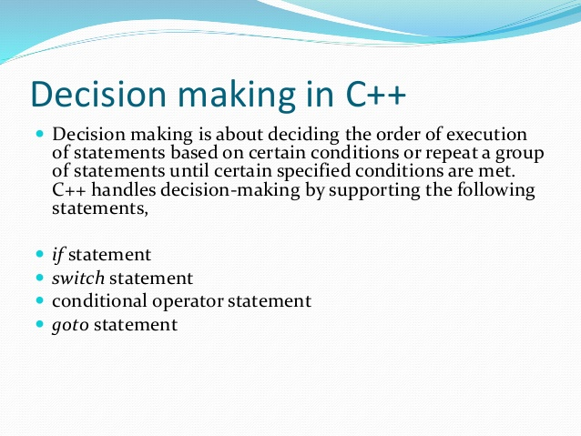

Slide 2
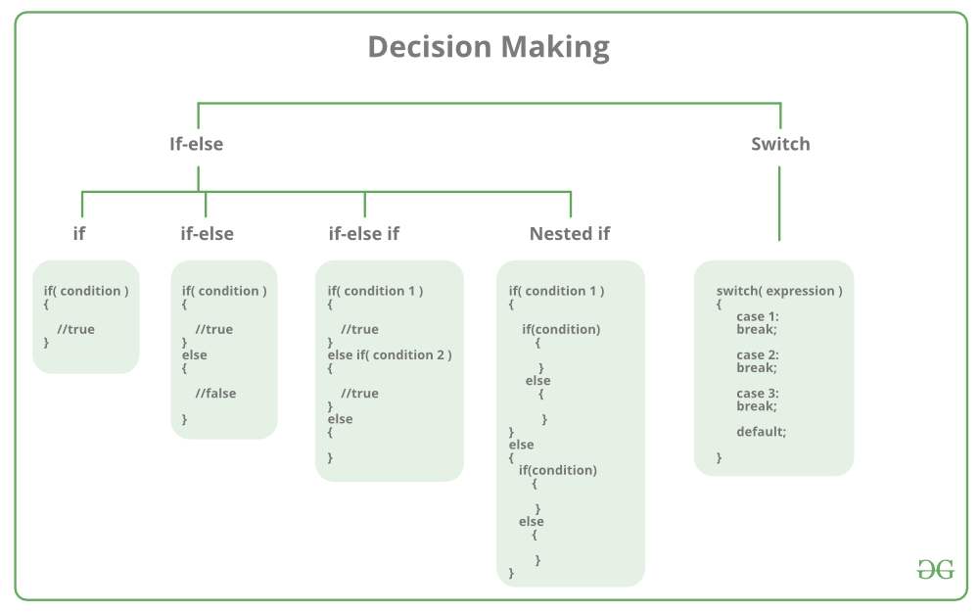

Slide 3
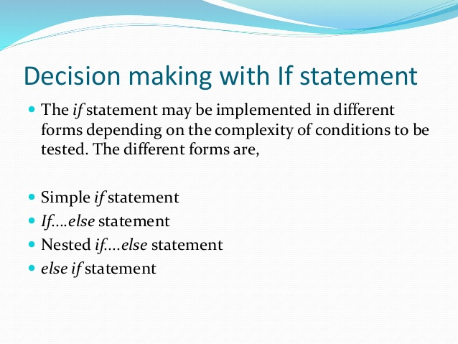

Slide 4
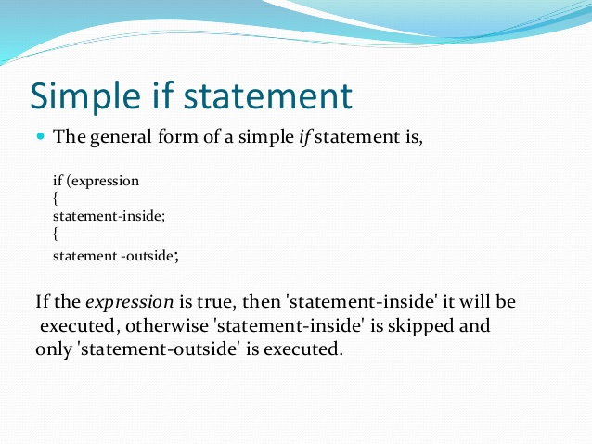

Slide 5
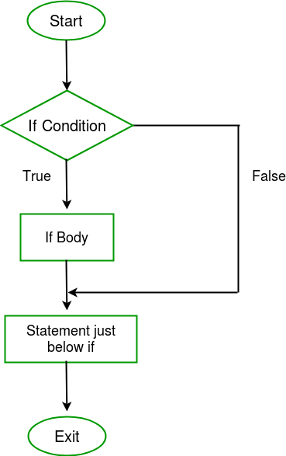

Slide 6
// C++ program to illustrate If statement
#include<iostream>
using namespace std;
int main()
{
int i = 10;
if (i > 15)
{
cout<<"10 is less than 15";
}
cout<<"I am Not in if";
return 0;
}

Slide 7
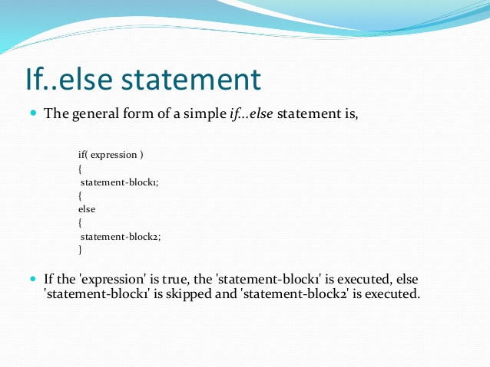

Slide 8
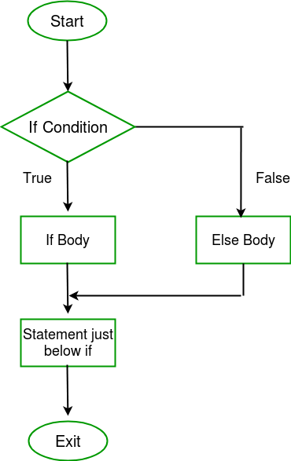

Slide 9
// C++ program to illustrate if-else statement
#include<iostream>
using namespace std;
int main()
{
int i = 20;
if (i < 15)
cout<<"i is smaller than 15";
else
cout<<"i is greater than 15";
return 0;
}

Slide 10
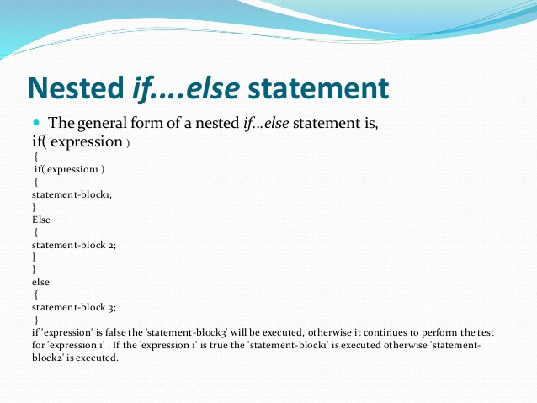

Slide 11
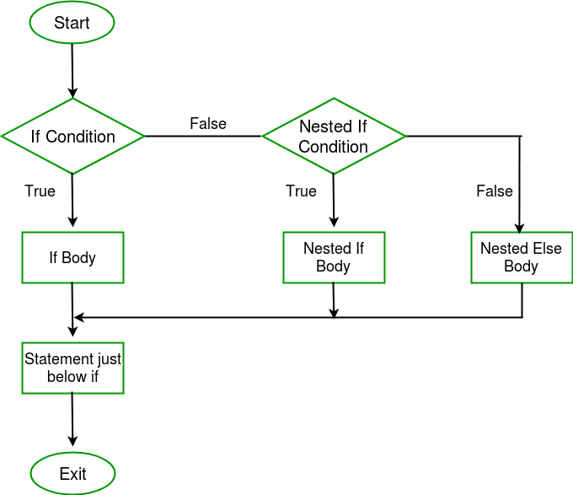

Slide 12
// C++ program to illustrate nested-if statement
#include <iostream>
using namespace std;
int main()
{
int i = 15;
if (i <= 10)
{
// First if statement
if (i < 15)
cout<<"i is smaller than 15\n";
// Nested - if statement
// Will only be executed if statement above
// is true
if (i < 12)
cout<<"i is smaller than 12 too\n";
else
cout<<"i is greater than 15";
}
else if (I >=10){}
return 0;
}

Slide 13
if-else-if ladder in c++
if (condition)
statement;
else if (condition)
statement;
.
.
else
statement;

Slide 14
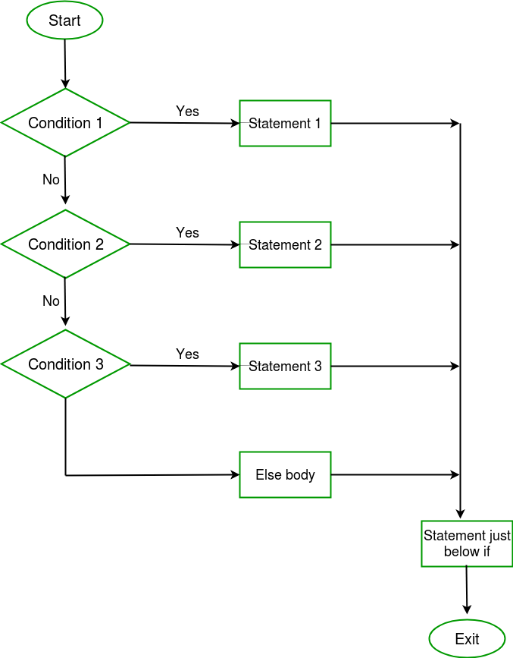

Slide 15
// C++ program to illustrate if-else-if ladder
#include<iostream>
using namespace std;
int main()
{
int i = 16;
if (i == 10)
cout<<"i is 10";
else if (i == 15)
cout<<"i is 15";
else if (i == 20)
cout<<"i is 20";
Return 0;
}

Slide 16
SWITCH STATEMENT
Switch case statement evaluates a given expression and based on the evaluated value(matching a certain condition), it executes the statements associated with it. Basically, it is used to perform different actions based on different conditions(cases).
Switch case statements follow a selection-control mechanism and allow a value to change control of execution.
They are a substitute for long if statements that compare a variable to several integral values.
The switch statement is a multiway branch statement. It provides an easy way to dispatch execution to different parts of code based on the value of the expression.

Slide 17
Syntax:
switch (n)
{
case 1: // code to be executed if n = 1;
break;
case 2: // code to be executed if n = 2;
break;
default: // code to be executed if n doesn't match any cases
}

Slide 18
Important Points About Switch Case Statements:
1) The expression provided in the switch should result in a
constant value otherwise it would not be valid. Some valid expressions for switch case will be,
// Constant expressions allowed
switch(1+2+23) switch(1*2+3%4)
// Variable expression are allowed provided
// they are assigned with fixed values
switch(a*b+c*d) switch(a+b+c)

Slide 19
2) Duplicate case values are not allowed.
3) The default statement is optional. Even if the switch case statement do not have a default statement, it would run without any problem.
4) The break statement is used inside the switch to terminate a statement sequence. When a break statement is reached, the switch terminates, and the flow of control jumps to the next line following the switch statement.
5) The break statement is optional. If omitted, execution will continue on into the next case. The flow of control will fall through to subsequent cases until a break is reached.
6) Nesting of switch statements is allowed, which means you can have switch statements inside another switch. However nested switch statements should be avoided as it makes the program more complex and less readable.
7) Switch statements are limited to integer values only in the check condition.

Slide 20
Some important keywords:
Break: This keyword is used to stop the execution inside a switch block. It helps to terminate the switch block and break out of it.
2) Default: This keyword is used to specify the set of statements to execute if there is no case match.
Note: Sometimes when default is not placed at the end of switch case program, we should use break statement with the default case.

Slide 22
// C++ program to demonstrate syntax of switch
#include <iostream>
using namespace std;
// Driver Code
int main()
{
int x = 2;
switch (x) {
case 1:
cout << "Choice is 1";
break;
case 2:
cout << "Choice is 2";
break;
case 3:
cout << "Choice is 3";
break;
default:
cout << "Choice other than 1, 2 and 3";
break;
}
return 0;
}

Slide 23
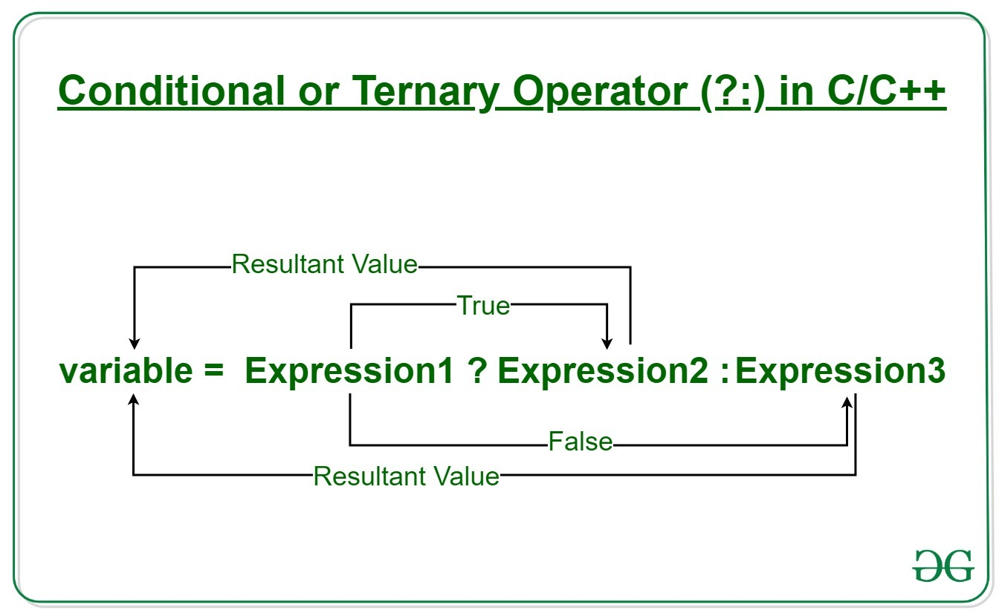
Conditional or Ternary Operator (?:) in C++
The conditional operator is kind of similar to the if-else statement as it does follow the same algorithm as of if-else statement but the conditional operator takes less space and helps to write the if-else statements in the shortest way possible.
Syntax: The conditional operator is of the form
variable = Expression1 ? Expression2 : Expression3

Slide 24
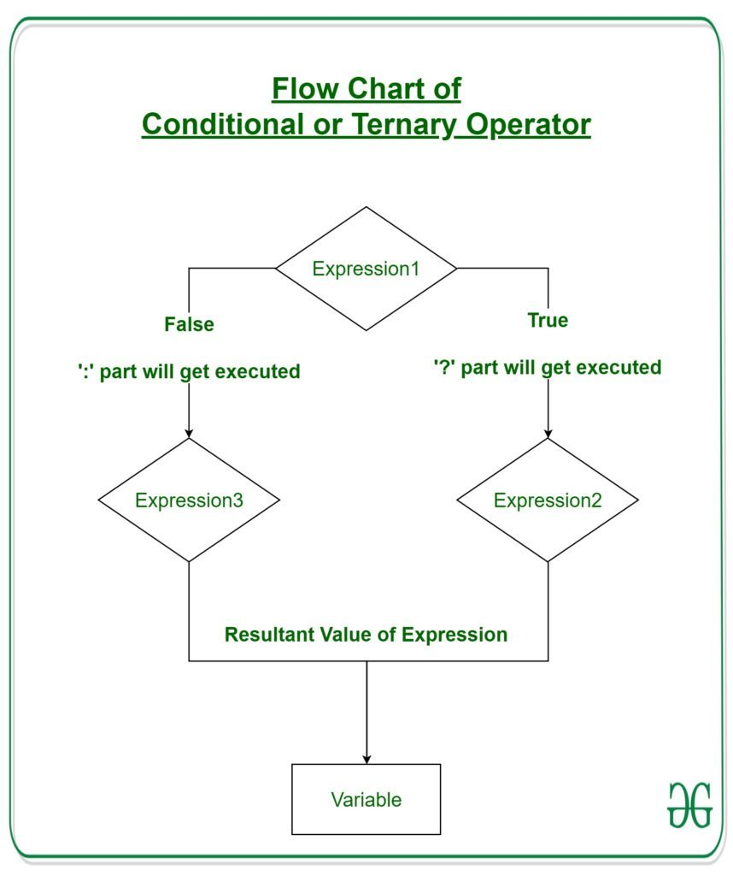

Slide 25
// C++ program to find largest among two
// numbers using ternary operator
#include <iostream>
using namespace std;
int main()
{
// variable declaration
int n1 = 5, n2 = 10, max;
// Largest among n1 and n2
max = (n1 > n2) ? n1 : n2;
// Print the largest number
cout << "Largest number between " << n1
<< " and " << n2
<< " is " << max;
return 0;
}

Slide 26
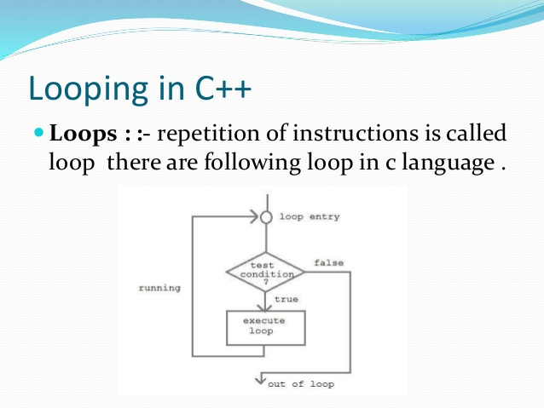

Slide 27
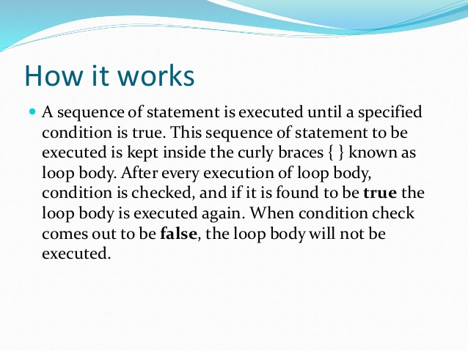

Slide 28
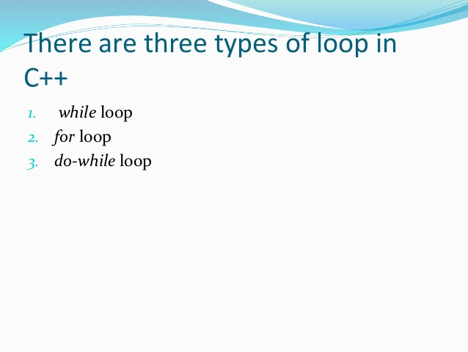

Slide 29
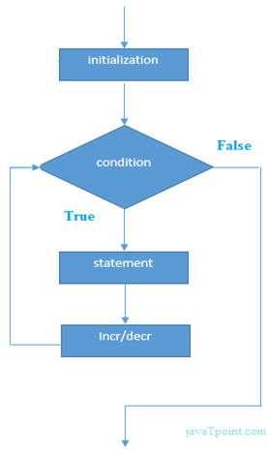
C++ For Loop
The C++ for loop is used to iterate a part of the program several times. If the number of iteration is fixed, it is recommended to use for loop than while or do-while loops.
The C++ for loop is same as C/C#. We can initialize variable, check condition and increment/decrement value.
for(initialization; condition; incr/decr)
{
//code to be executed
}

Slide 30
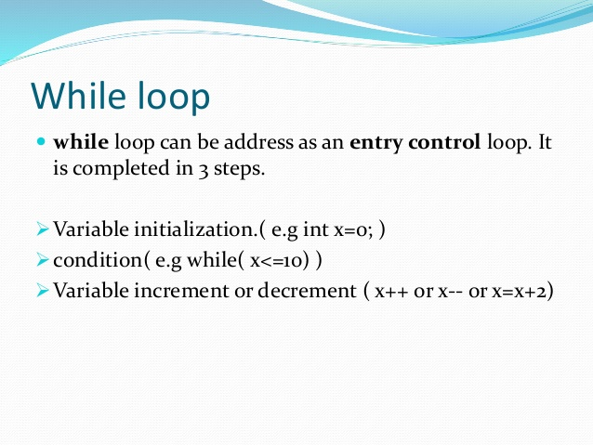

Slide 31
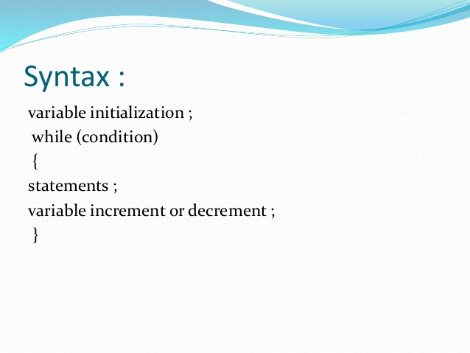

Slide 32
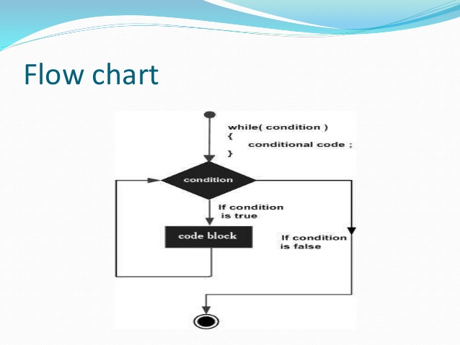

Slide 33
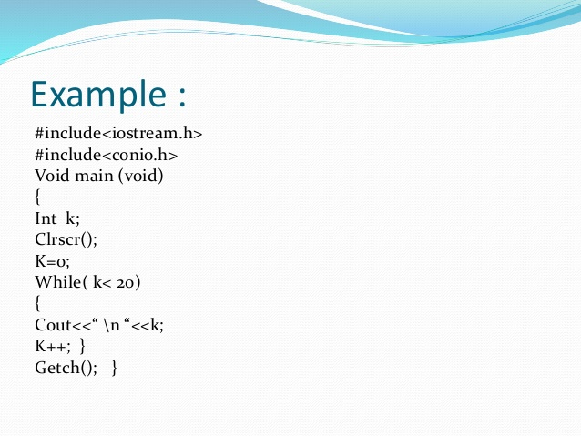

Slide 34
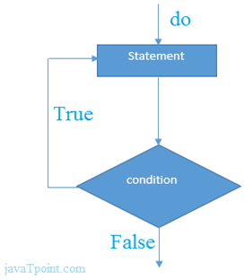
C++ Do-While Loop
The C++ do-while loop is used to iterate a part of the program several times. If the number of iteration is not fixed and you must have to execute the loop at least once, it is recommended to use do-while loop
The C++ do-while loop is executed at least once because condition is checked after loop body.
do{
//code to be executed
}while(condition);

Slide 35
C++ do-while Loop Example
Let's see a simple example of C++ do-while loop to print the table of 2.
#include <iostream>
using namespace std;
int main() {
int i = 2;
do{
cout<<i<<"\n";
i++;
} while (i <= 10) ;
}

Slide 36
C++ Nested do-while Loop
#include <iostream>
using namespace std;
int main() {
int i = 1;
do{
int j = 1;
do{
cout<<i<<"\n";
j++;
} while (j <= 3) ;
i++;
} while (i <= 3) ;
}

Slide 37
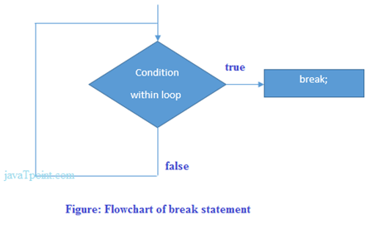
C++ Break Statement
The C++ break is used to break loop or switch statement. It breaks the current flow of the program at the given condition. In case of inner loop, it breaks only inner loop.

Slide 38
C++ Break Statement Example
Let's see a simple example of C++ break statement which is used inside the loop.
#include <iostream>
using namespace std;
int main() {
for (int i = 1; i <= 10; i++)
{
if (i == 5)
{
break;
}
cout<<i<<"\n";
}
}

Slide 39
C++ Continue Statement
The C++ continue statement is used to continue loop. It continues the current flow of the program and skips the remaining code at specified condition. In case of inner loop, it continues only inner loop.
C++ Continue Statement Example
#include <iostream>
using namespace std;
int main()
{
for(int i=1;i<=10;i++){
if(i==5){
continue;
}
cout<<i<<"\n";
}
}

Slide 40
C++ Goto Statement
The C++ goto statement is also known as jump statement. It is used to transfer control to the other part of the program. It unconditionally jumps to the specified label.
#include <iostream>
using namespace std;
int main()
{
ineligible:
cout<<"You are not eligible to vote!\n";
cout<<"Enter your age:\n";
int age;
cin>>age;
if (age < 18){
goto ineligible;
}
else
{
cout<<"You are eligible to vote!";
}
}

